Slide 1

Time Series Forecasting (ft. LSTM)
Hillary Scannell
PhD student, School of Oceanography, University of Washington
Research Intern at Tableau
July 12, 2018

Slide 2

We live at the intersection of two unprecedented ages
Notes:
Tableau is a company well poised to tackle the problems of today, while also anticipating the challenges of tomorrow. It does this by helping people see and make sense of our world by providing data-driven advanced analytics to answer pivotal questions facing society.
Information age,
Anthropocene, new geological age characterized by exponential negative and rapid impacts of human activities on Earth’s natural systems.
As a scientist, I am interested in developing and applying data science tools for scientific application.

Slide 3
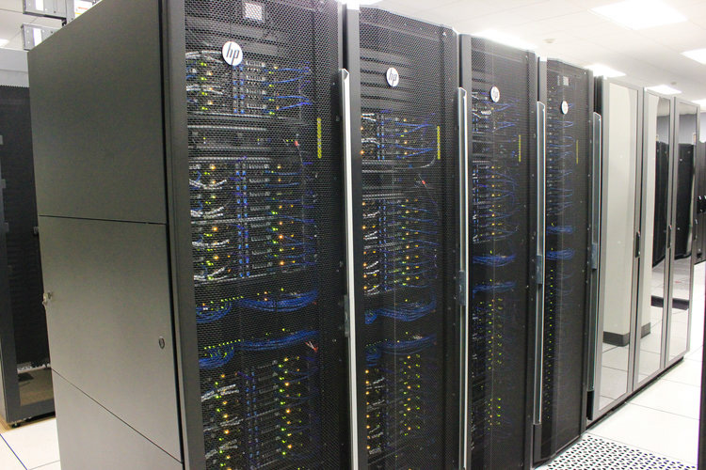
We live at the intersection of two unprecedented ages
The Information Age
Notes:
Tableau is a company well poised to tackle the problems of today, while also anticipating the challenges of tomorrow. It does this by helping people see and make sense of our world by providing data-driven advanced analytics to answer pivotal questions facing society.
Information age,
Anthropocene, new geological age characterized by exponential negative and rapid impacts of human activities on Earth’s natural systems.
As a scientist, I am interested in developing and applying data science tools for scientific application.

Slide 4

We live at the intersection of two unprecedented ages
The Information Age
Notes:
Tableau is a company well poised to tackle the problems of today, while also anticipating the challenges of tomorrow. It does this by helping people see and make sense of our world by providing data-driven advanced analytics to answer pivotal questions facing society.
Information age,
Anthropocene, new geological age characterized by exponential negative and rapid impacts of human activities on Earth’s natural systems.
As a scientist, I am interested in developing and applying data science tools for scientific application.

Slide 5

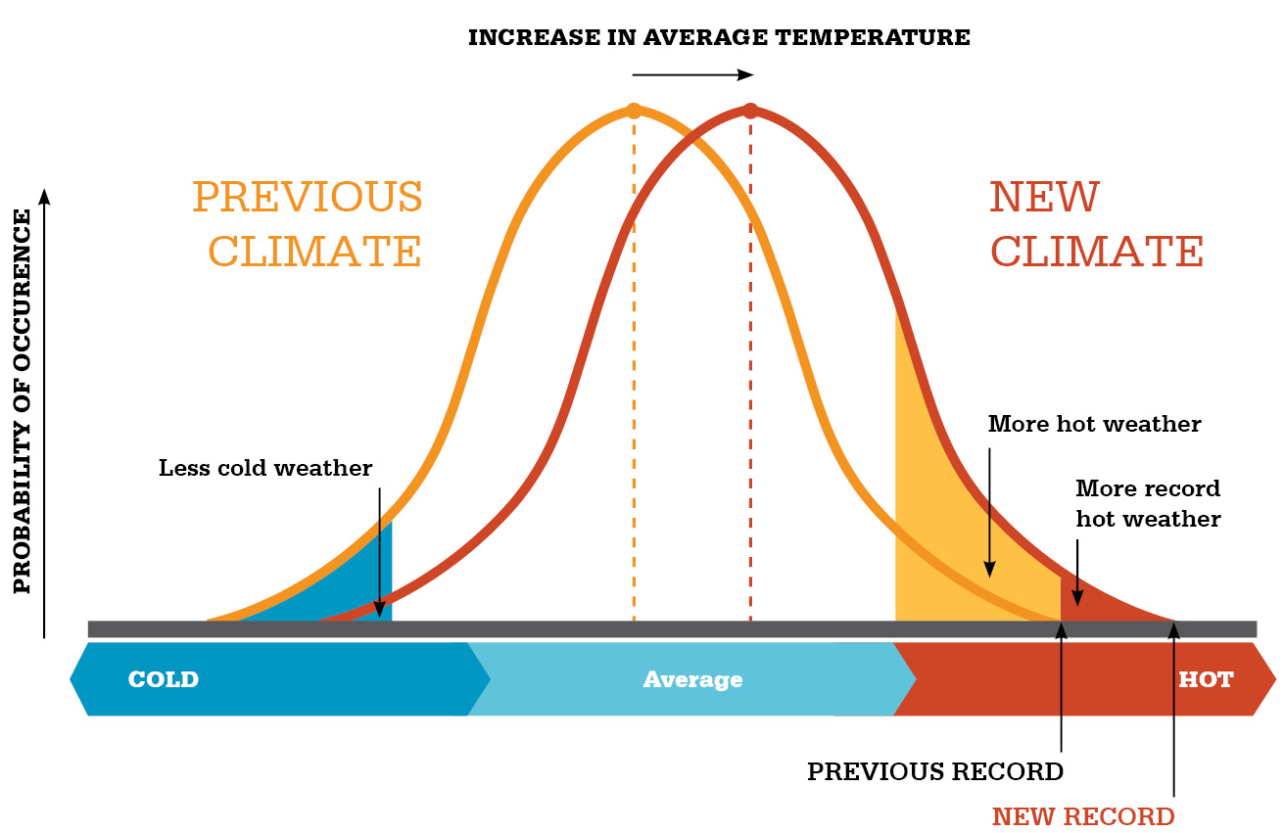
Climate Change
IPCC
Warming is “unequivocal”
If no action is taken, we can expect “further warming and long-lasting changes in all components of the climate system, increasing the likelihood of severe, pervasive and irreversible impacts for people and ecosystems.”
Modified from IPCC (2007), from climatecommission.gov.au
Notes:
Intergovernmental Panel on Climate Change
IPCC, which has been tracking climate change since 1988
Human are responsible: “Human influence on the climate system is clear, and recent anthropogenic emissions of greenhouse gases are the highest in history,”
It’s already happening
It is going to get far worse. “Heatwaves will occur more often and last longer… extreme precipitation events will become more intense and frequent in many regions. The ocean will continue to warm and acidify, global mean sea level to rise”. 3.7-4.8ºC warming by the end of the Century
Much of the recent warming has been in the ocean, becoming more acidic too
Climate changes will hit developing nations unproportionally, but we are all vulnerable
We already have the answers we need to tackle climate change, but effective mitigation will not be achieved by individuals

Slide 6
Climate Change
IPCC
Warming is “unequivocal”
If no action is taken, we can expect “further warming and long-lasting changes in all components of the climate system, increasing the likelihood of severe, pervasive and irreversible impacts for people and ecosystems.”
Marine Heatwaves
Modified from IPCC (2007), from climatecommission.gov.au
Notes:
Intergovernmental Panel on Climate Change
IPCC, which has been tracking climate change since 1988
Human are responsible: “Human influence on the climate system is clear, and recent anthropogenic emissions of greenhouse gases are the highest in history,”
It’s already happening
It is going to get far worse. “Heatwaves will occur more often and last longer… extreme precipitation events will become more intense and frequent in many regions. The ocean will continue to warm and acidify, global mean sea level to rise”. 3.7-4.8ºC warming by the end of the Century
Much of the recent warming has been in the ocean, becoming more acidic too
Climate changes will hit developing nations unproportionally, but we are all vulnerable
We already have the answers we need to tackle climate change, but effective mitigation will not be achieved by individuals

Slide 7
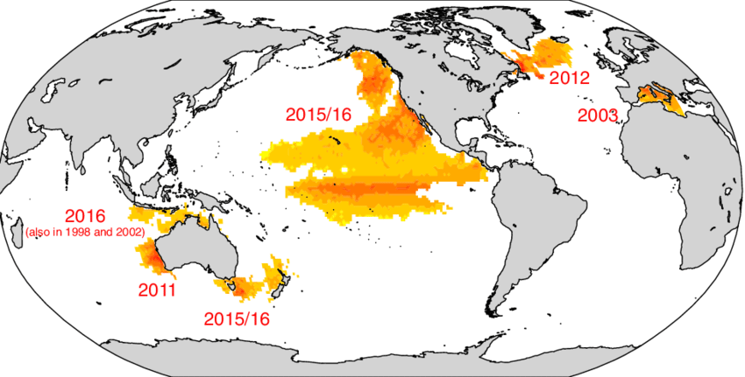
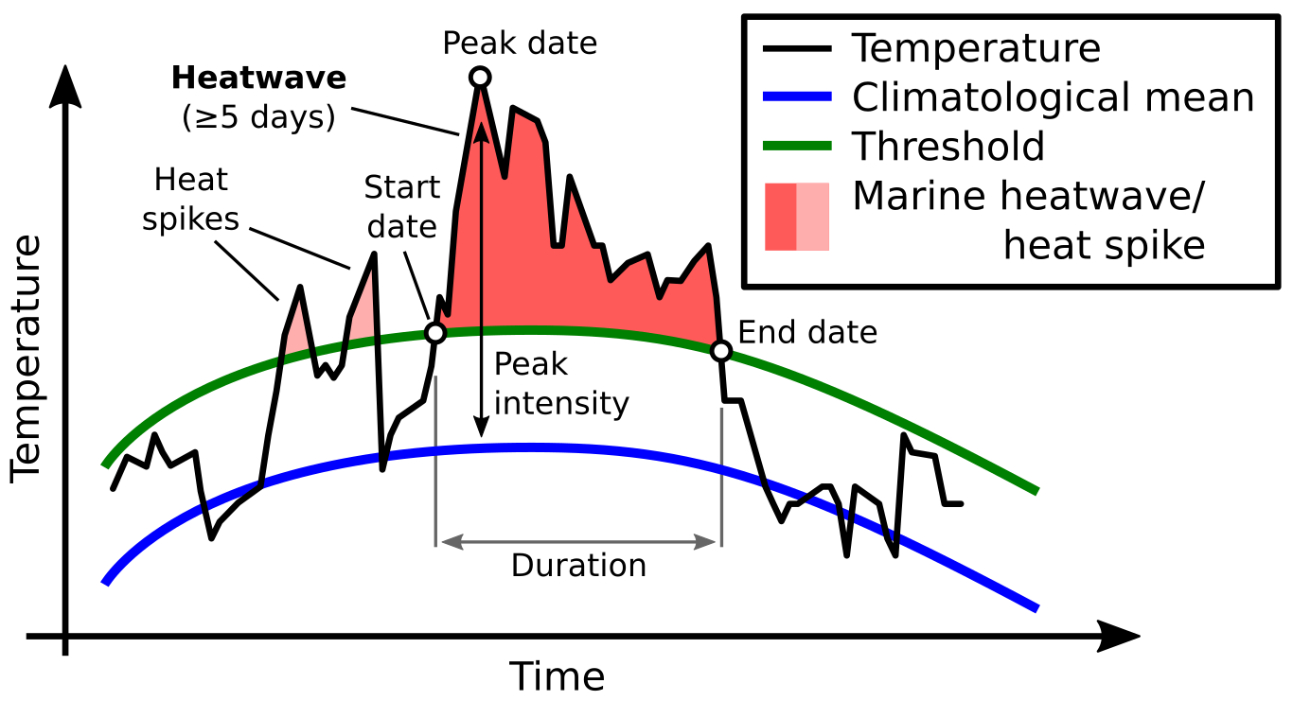
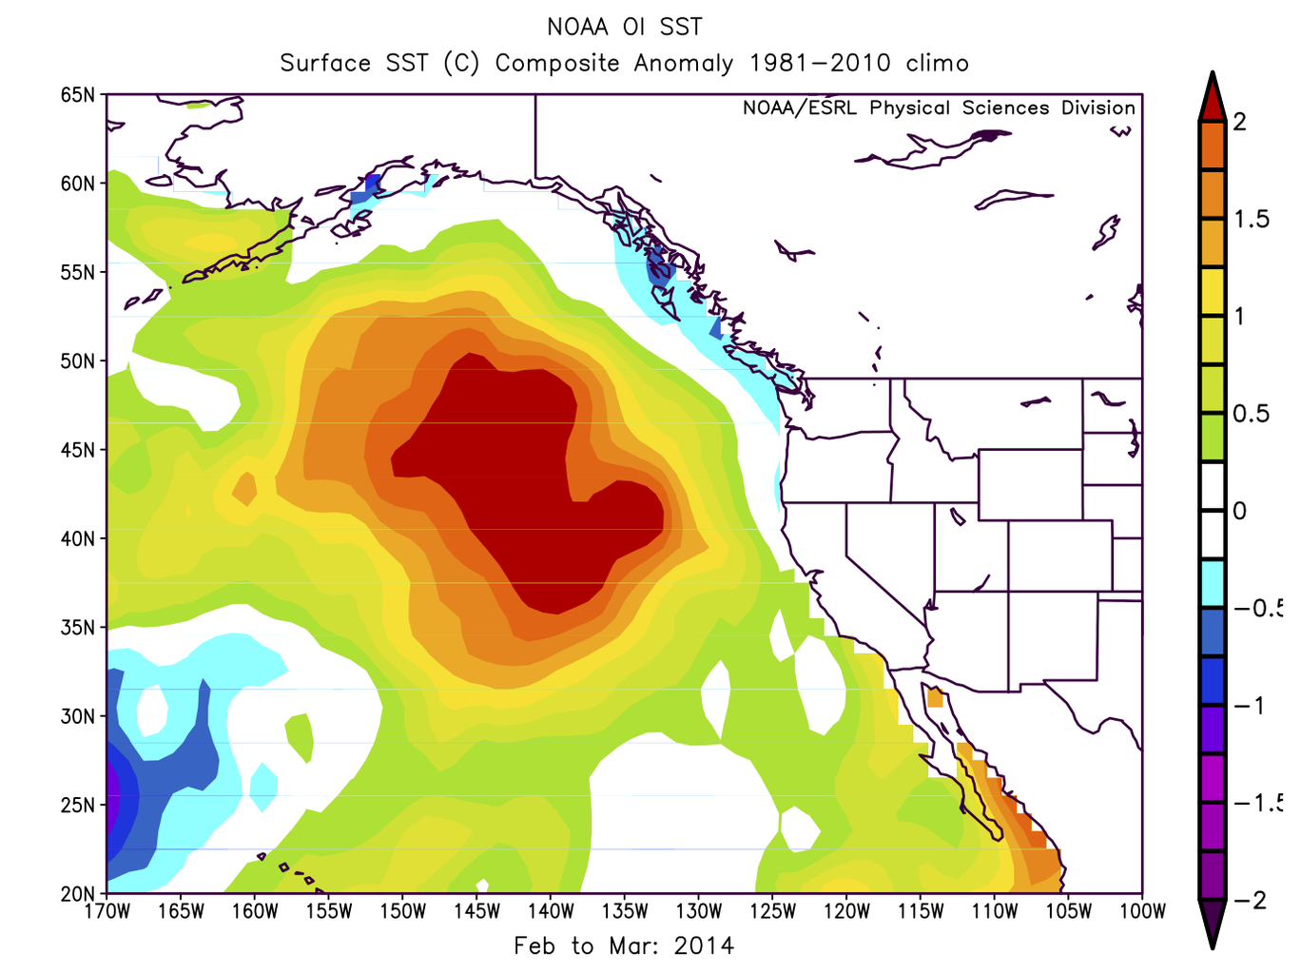
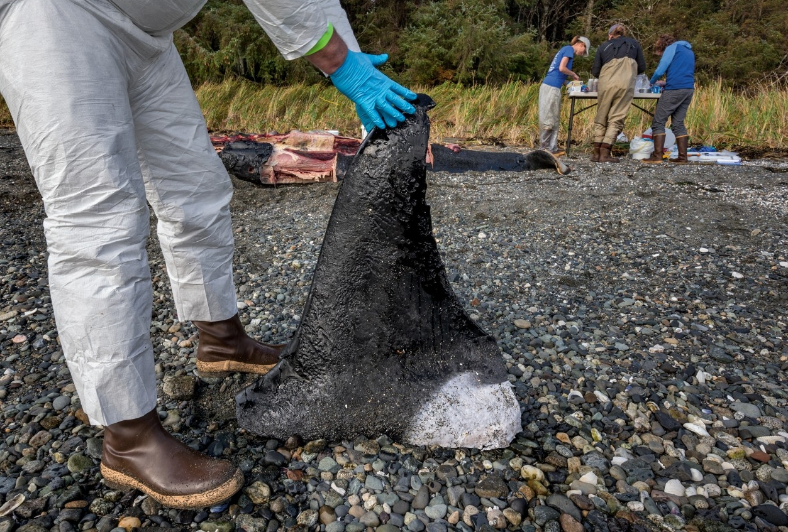

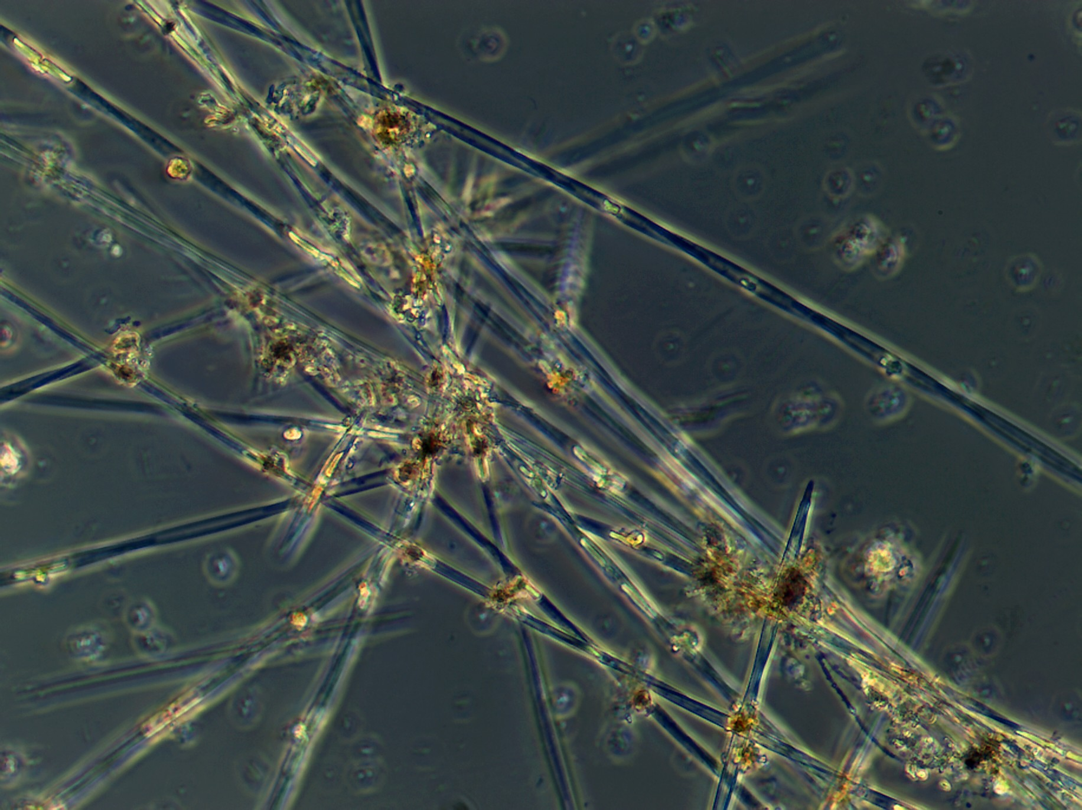
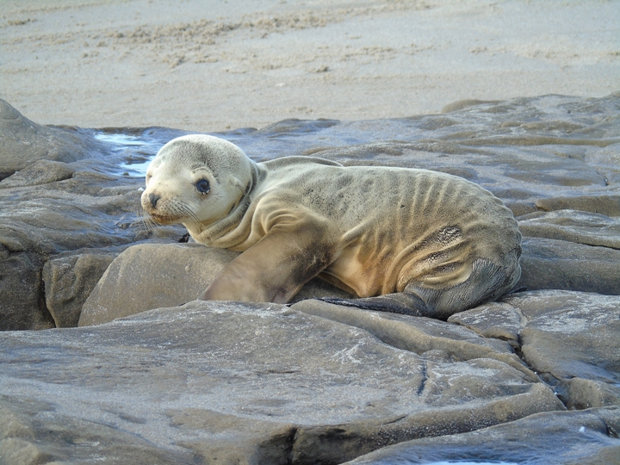
Marine Heatwaves
Global Phenomena
Frölicher and Laufkötter, 2018
… with local impacts
marineheatwaves.org

Slide 8
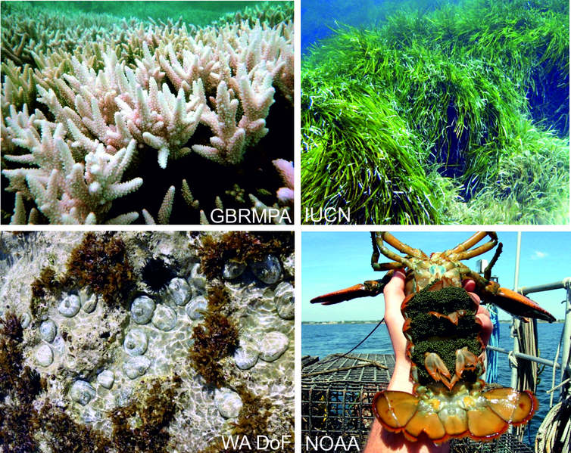
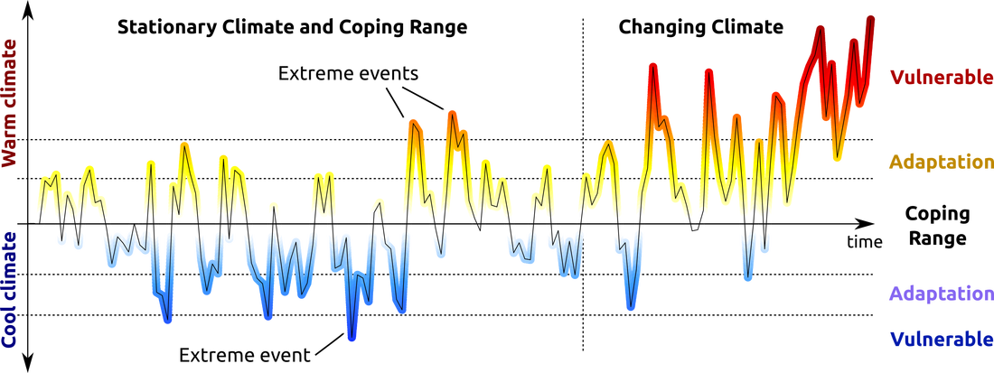
Marine Heatwaves
Longer and more frequent marine heatwaves over the past century
“54% increase in annual marine heatwave days globally. Importantly, these trends can largely be explained by increases in mean ocean temperatures, suggesting that we can expect further increases in marine heatwave days under continued global warming.”
Oliver et al., Nature Communications, 2018
marineheatwaves.org

Slide 9

Climate Change
The Three Pillars of the Response to Global Warming
Mitigation
Adaptation
Resilience
Notes:
So what can we do as scientist? >> advise by provide accurate facts
Mitigation: Slowing the rate of global warming
Adaptation: taking steps to live with the effects of global warming
Resilience: climate-proof economic and socials systems for the future
Resource: https://cop23.com.fj/mitigation-adaptation-resilience/

Slide 10
Climate Change
The Three Pillars of the Response to Global Warming
Mitigation
Adaptation
Resilience
Notes:
We’re going to develop reliable forecasts of extreme ocean temperature anomalies that will help communities prepare for and become more resilient to future marine heatwaves.
Resource: https://cop23.com.fj/mitigation-adaptation-resilience/

Slide 11
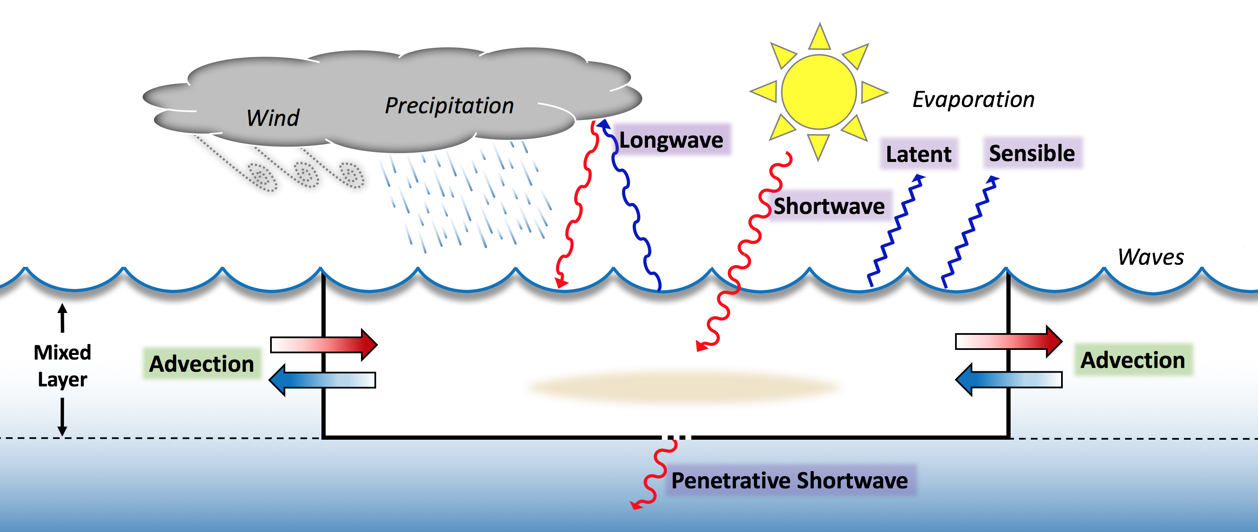
Physical Processes Controlling the Temperature at the Sea Surface
Entrainment

Slide 12
Mixed Layer Heat Balance
$$h\frac{∂T_{a}}{∂t} +h\left(v_{a}∙∇T_{a}+\left(\overline{v^{′}∙∇T^{′}}\right)\right)+∇∙\left(\int_{−h}^{0}{\hat{v}\hat{T}dz}\right)+\left(T_{a}−T_{−h}\right) × \left(\frac{∂h}{∂t}+v_{−h}∙∇h+w_{−h}\right) = \frac{Q_{net}}{ρc_{p}}$$
Moisan and Niiler, 1998
Entrainment
Notes:
Derived from the laws of conservation of mass and heat

Slide 13

Mixed Layer Heat Balance
$$h\frac{∂T_{a}}{∂t} +h\left(v_{a}∙∇T_{a}+\left(\overline{v^{′}∙∇T^{′}}\right)\right)+∇∙\left(\int_{−h}^{0}{\hat{v}\hat{T}dz}\right)+\left(T_{a}−T_{−h}\right) × \left(\frac{∂h}{∂t}+v_{−h}∙∇h+w_{−h}\right) = \frac{Q_{net}}{ρc_{p}}$$
Moisan and Niiler, 1998
Entrainment
Notes:
Derived from the laws of conservation of mass and heat

Slide 14
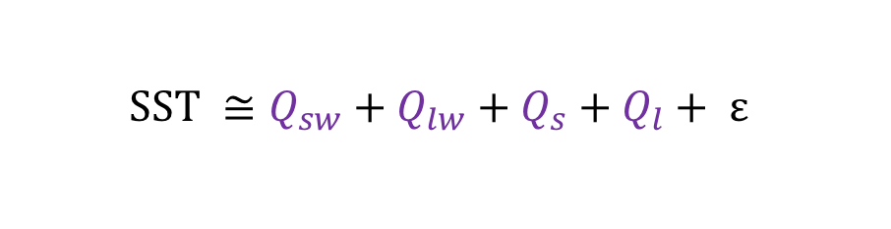
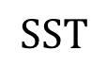
Simplest Model to Approximate Changes in Sea Surface Temperature
$$SST ≅Q_{sw}+Q_{lw}+Q_{s}+Q_{l}+ ε$$
( )
Wind speed
Air humidity
Air temperature
$$SST$$
Entrainment

Slide 15
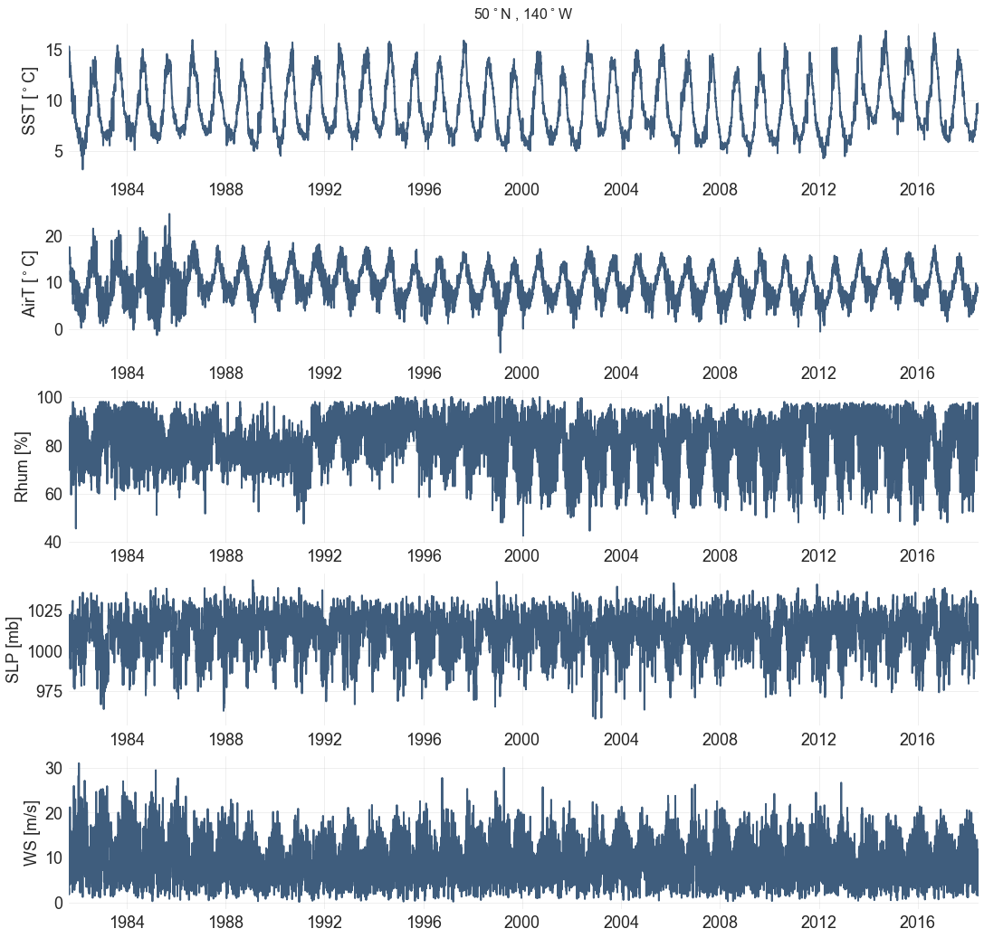
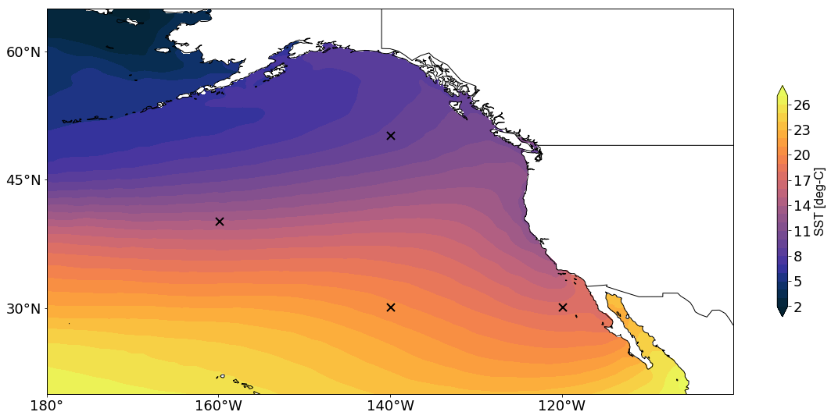
North Pacific Ocean
50ºN, 140ºW
40ºN, 160ºW
30ºN, 140ºW
30ºN, 120ºW
NOAA Optimum Interpolation Sea Surface Temperature
Daily on a ¼º global grid from 1981 to present
sea surface temperature
NOAA NCEP/NCAR Reanalysis
Daily on a 2.5º global grid from 1948 to present
surface air temperature
relative humidity
sea level pressure
wind speed

Slide 16
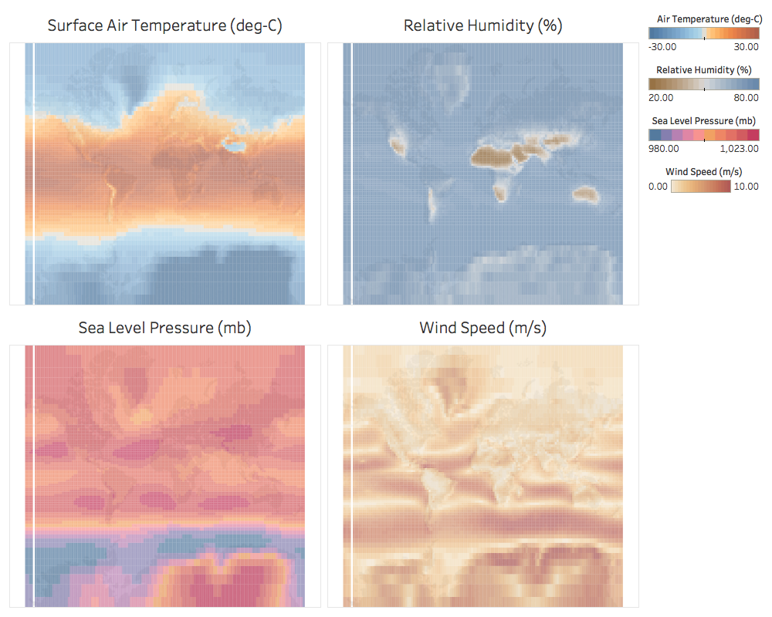

Slide 17
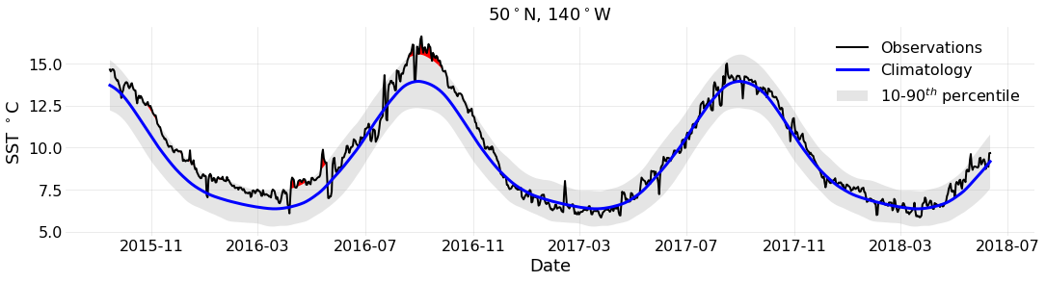
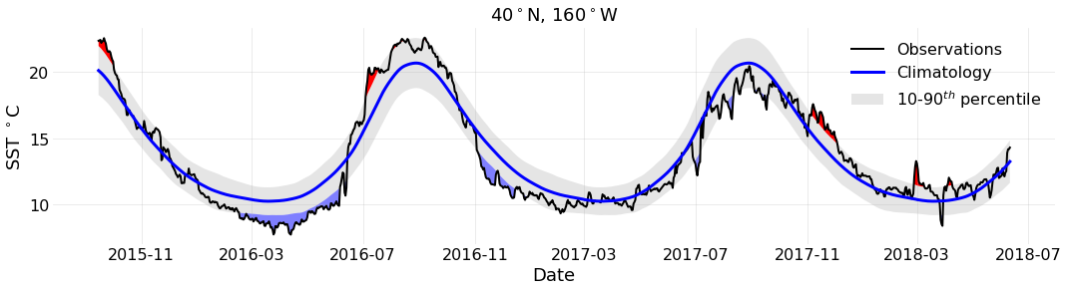
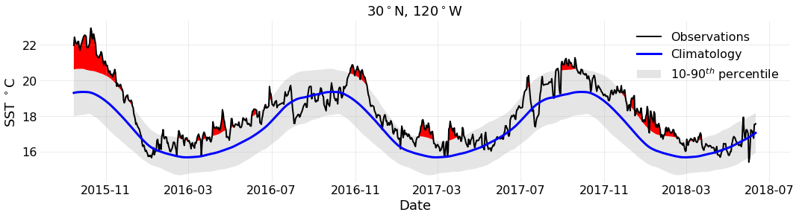
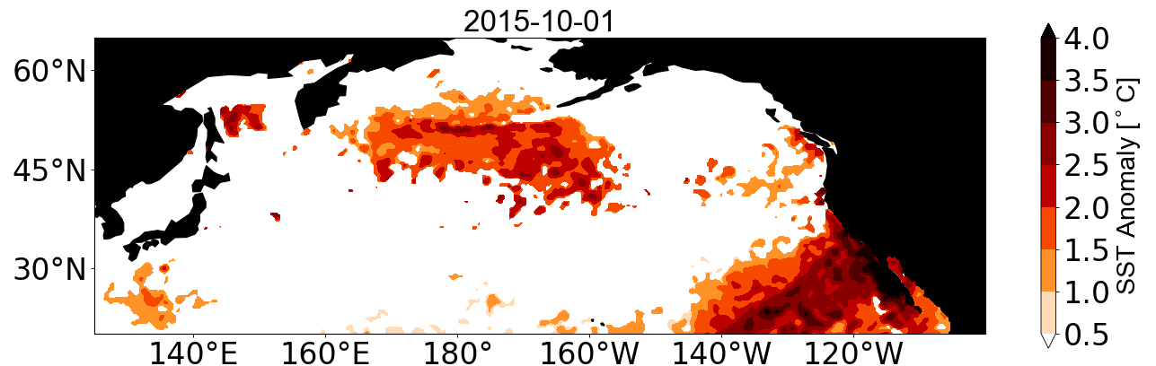
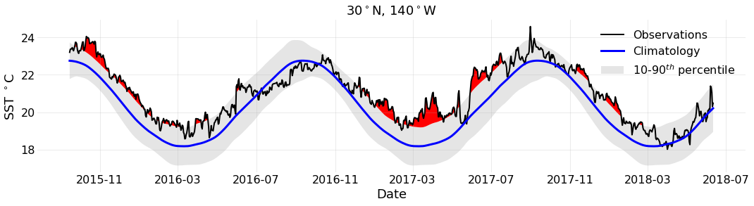
North Pacific Ocean
50ºN, 140ºW
40ºN, 160ºW
30ºN, 140ºW
30ºN, 120ºW
Marine Heatwaves
Sea Surface Temperature Anomalies

Slide 18
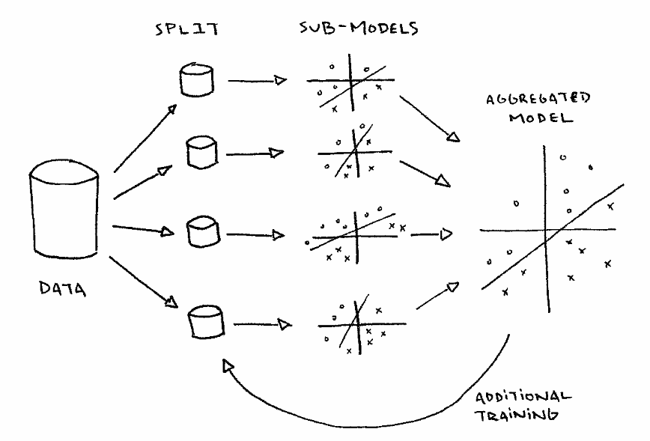
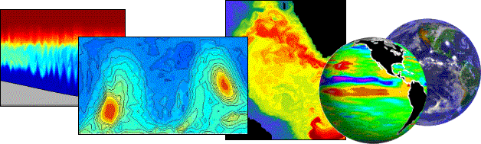
What methods do we have to predict sea surface temperature?
Numerical Models | Data Learning Models
Physics based Uses a series of differential equations to describe variation in SST High level of sophistication, computational effort and time Models differ greatly in different ocean areas | Algorithms that learn the best model from the data Requires some domain expertise to interpret model output

Slide 19
Few examples from the literature

Slide 20
Start with simple models as baselines, add complexity to see if the predictions can improve.
ARIMA: univariate time series
-AR, AM
- TBATS

Slide 21
Long Short-Term Memory (LSTMS)
LSTM is a type of Recurrent Neural Network (RNN)
RNN uses internal state (memory) to process sequences of inputs
Applied to sequence data
Strengths:
Takes advantage of autocorrelations
Able to maintain state and recognize patterns over the length of the time series
Enables long term persistence in addition to short term
Introduced by Hochreiter & Schmidhuber, 1997

Slide 22
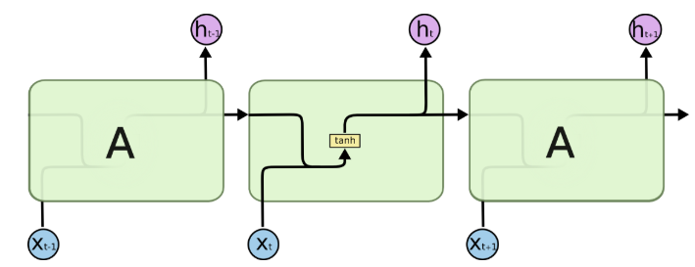
RNN
Networks with loops that allow information to persist
Allows persistence
Has a memory of what happened previously
Form a chain architecture of repeating modules, typically with a structure like tanh.
Long term memory problem
Notes:
Vanilla RNNs have a repeating module with a simple structure

Slide 23
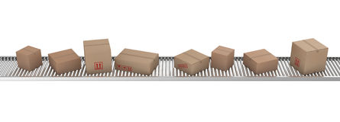
LSTM Architecture
C _{t -1}
C _{t}
A very important part of the architecture is its cell state
Notes:
Designed to avoid the long-term dependency problem
Cell state: can think of like a conveyor belt
Runs straight down entire chain with only some minor linear iteractions
Easy for information to flow along unchanged
Cell states are regulated by structures called gates
Gates can either add or remove information to the cell state
Sigmoid layer outputs number between zero and one, telling the gate how much of each component should be let through. Zero means “let nothing through, while one means let everything through.

Slide 24
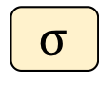
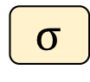
LSTM Architecture
C _{t -1}
C _{t}
A very important part of the architecture is its cell state
The cell state is regulated by structures called gates.
Gates are pointwise operations.
C _{t -1}
C _{t}
X
+
$$σ$$
$$σ$$
Sigmoid neural net layer
Notes:
Designed to avoid the long-term dependency problem
Cell state: can think of like a conveyor belt
Runs straight down entire chain with only some minor linear iteractions
Easy for information to flow along unchanged
Cell states are regulated by structures called gates
Gates can either add or remove information to the cell state
Sigmoid layer outputs number between zero and one, telling the gate how much of each component should be let through. Zero means “let nothing through, while one means let everything through.

Slide 25
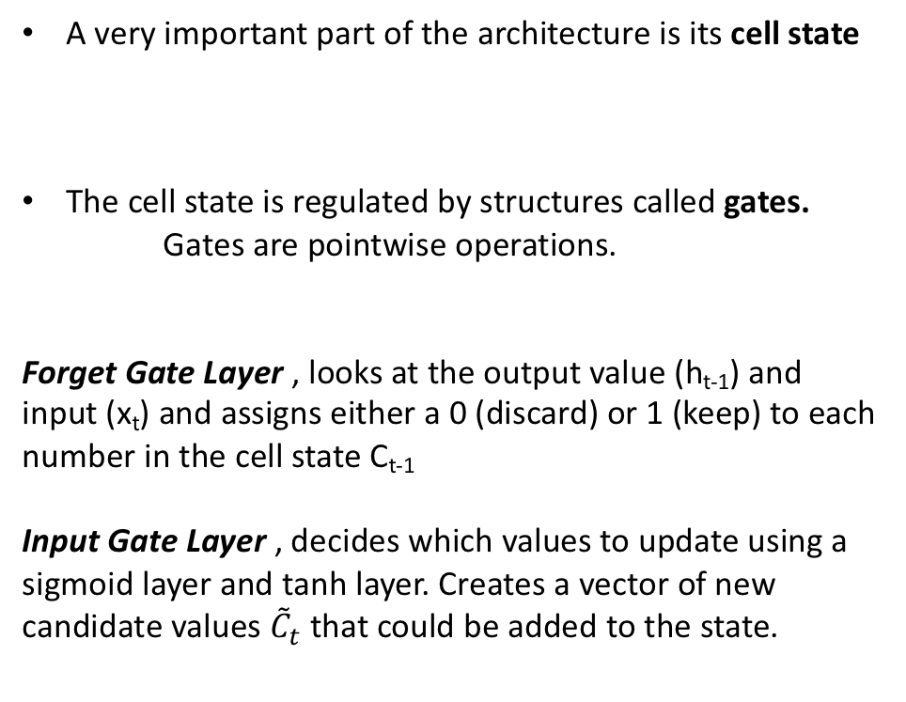
LSTM Architecture
C _{t -1}
C _{t}
A very important part of the architecture is its cell state
The cell state is regulated by structures called gates.
Gates are pointwise operations.
Forget Gate Layer , looks at the output value (h_{t-1}) and input (x_{t}) and assigns either a 0 (discard) or 1 (keep) to each number in the cell state C_{t-1}
Input Gate Layer , decides which values to update using a sigmoid layer and tanh layer. Creates a vector of new candidate values ${\tilde{C}}_{t}$ that could be added to the state.
C _{t -1}
C _{t}
X
+
$$σ$$
$$σ$$
Sigmoid neural net layer
Notes:
Designed to avoid the long-term dependency problem
Cell state: can think of like a conveyor belt
Runs straight down entire chain with only some minor linear iteractions
Easy for information to flow along unchanged
Cell states are regulated by structures called gates
Gates can either add or remove information to the cell state
Sigmoid layer outputs number between zero and one, telling the gate how much of each component should be let through. Zero means “let nothing through, while one means let everything through.

Slide 26
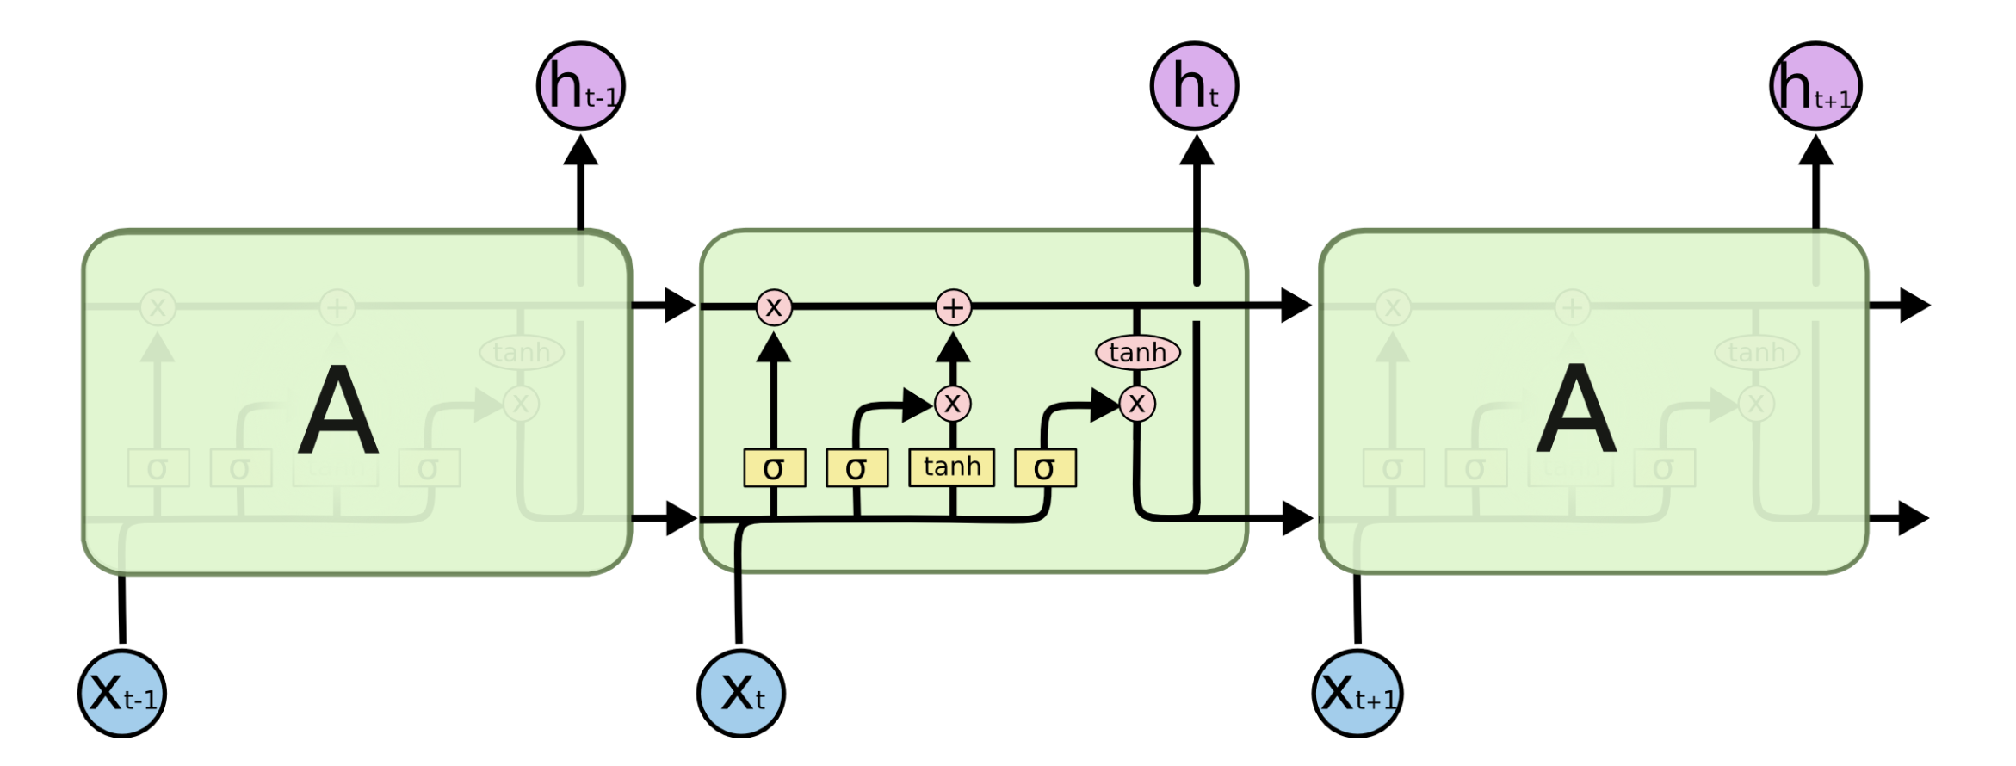
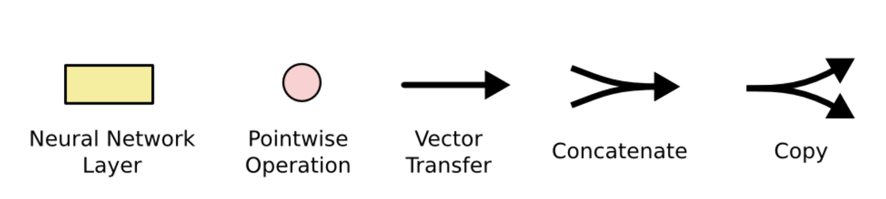
http://colah.github.io/posts/2015-08-Understanding-LSTMs/

Slide 27
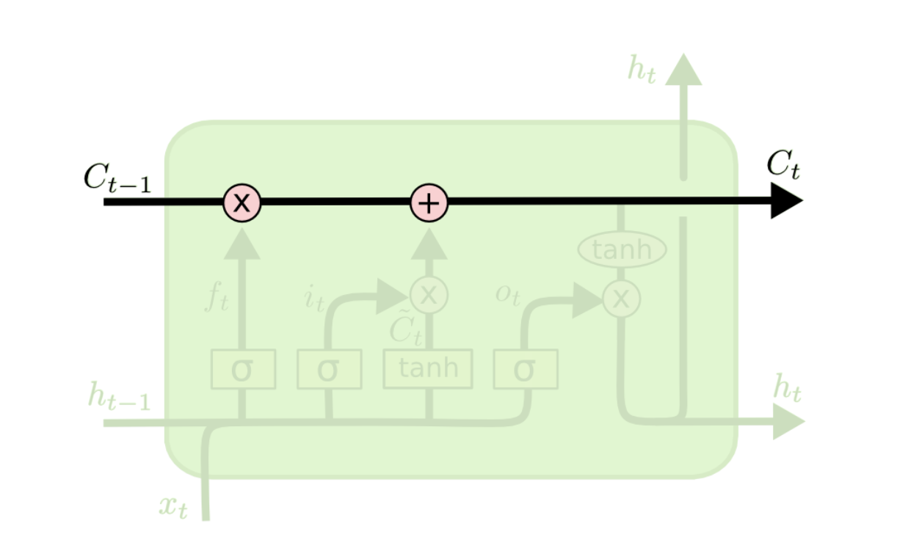

Slide 28
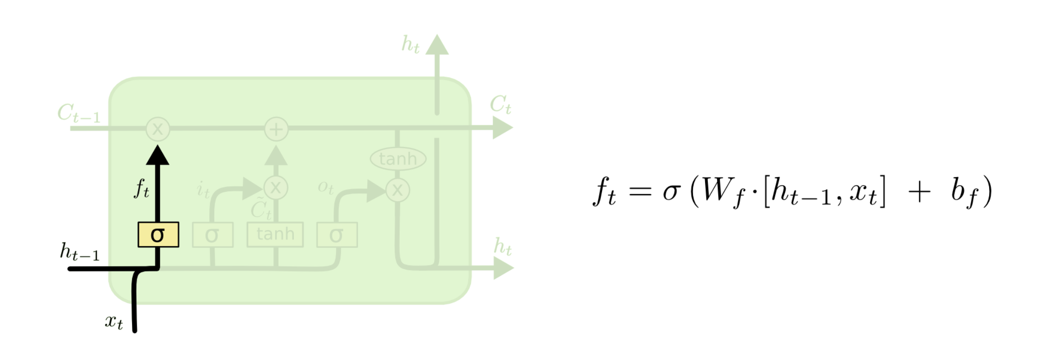

Slide 29
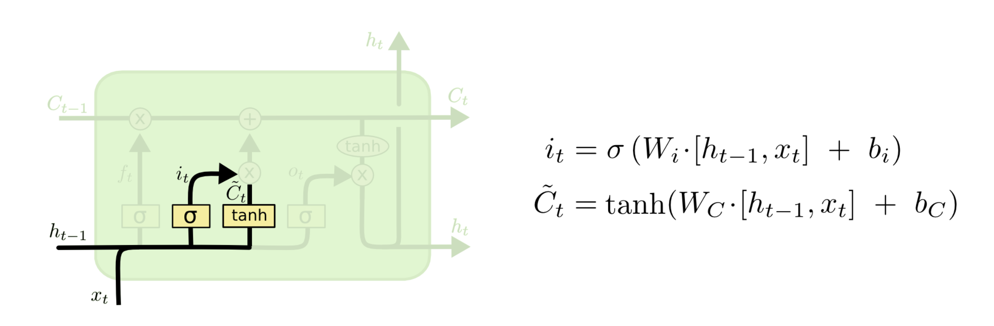

Slide 30
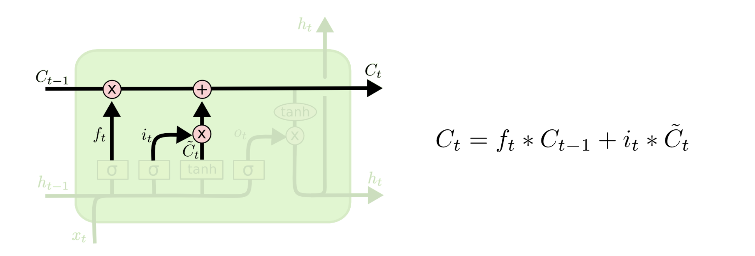

Slide 31
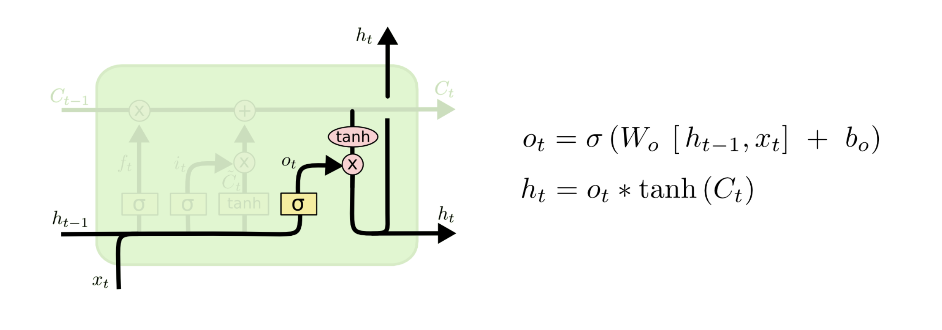

Slide 32
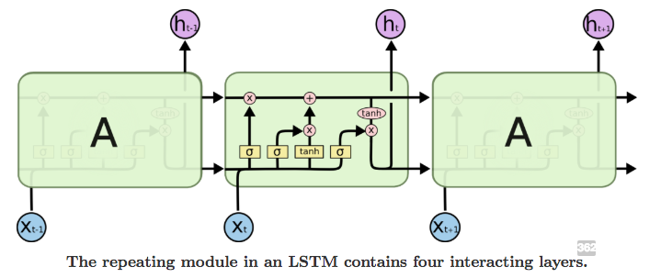
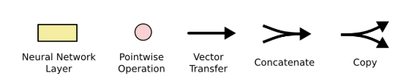
Developing a LSTM using Keras
Batch Size
number of training examples in one forward/backward pass of a RNN before a weight update
Batch size must be evenly divisible into both training and testing lengths (e.g. training length/batch size and test length/batch size must both be whole numbers)
Time Steps
Number of lags included in the training/testing set
Epochs
Total number of forward/backward pass iterations
Typically more improves model performance unless overfitting occurs

Slide 33
Setting up a Stateful LSTM Model
Stateful = no reshuffling between batches
“last state for each sample at index i in a batch will be used as initial state for the sample of index i in the following batch” – Keras documentation
Time dependency is preserved
Higher accuracy than stateless by leveraging autocorrelations present in the time series
In stateless mode, Keras shuffles samples and the dependencies between the time series and lagged version of itself are lost.

Slide 34
Building the LSTM Model
Keras_model_sequenctial()
Add layers like stacking bricks
(1) LSTM layer – model time series relationship
(2) fully-connected dense layer – map output of LSTM layer to a final prediction

Slide 35
Backtesting
Time series cross validation
Cross validation is the process of developing models on sub-sampled data against a validation set
Used to determine the accuracy and error range
Backtesting takes a time series and splits it into multiple uninterupted sequences offset at various windows

Slide 36
Conclusion
Build stateful LSTM with Keras
Benchmark and time series cross validation using backtesting
Compare MSE to other techniques

Slide 37
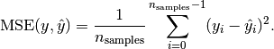
Mean squared Error
Scikit-learn
Risk metric corresponding to expected value of the quadratic error or loss
The smaller, the better

